Slide 1
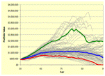
Advanced Retirement Analysis and Planning
Advanced Retirement Planning
Presented by:
Stav Adler CSWP, CPCA
Retirement Analyst
Investment Advisor
www.stavadler.com
Tel: 604-718-7519
Email: sadler@pifinancialcorp.com
Notes:
1

Slide 2
Advanced Retirement Planning
Stav Adler CSWP, CPCA
Investment Advisor - PFP 15 Years
Certified Professional Consultant On Aging 5 Years
Specialized in Retirement Analysis 3 Years
Chartered Strategic Wealth Professional 2 Years
PI Financial Corp.
Investment management firm
39,000 clients
7 offices across Canada
2 ½ billion dollars under management
Notes:
2

Slide 3
Advanced Retirement Planning
How much is enough
for life long income?
Notes:
3

Slide 4
Advanced Retirement Planning
A Few Key Questions
Do we have enough money to retire with lifelong income?
What lifestyle options can we afford, now and in the future?
How will the different stages of retirement affect our finances?
How will selling our home or downsizing affect our future?
What is our probability of success?
What if something goes wrong?
Notes:
4

Slide 5
Advanced Retirement Planning
Three Unique Risks to Retirement
1. Inflation risk: Loss of buying power
2. Longevity risk: Outliving your savings
3. Investment risk:
A. Sequence of Returns
(technology crash, credit crisis)
B. Reverse Dollar Cost Averaging
(advantage becomes disadvantage)
___________________________________________
Myth of Averages
(average return-inflation-lifespan)
Notes:
5

Slide 6
Advanced Retirement Planning
Financial Analysis For Retirement
Incomes Pension incomes (Govt and Private), rental income, and annuity income.
Expenses Go Go years! Slow Go years! No Go years! Annual & Lumpy
Income Expenses greater than income.
Shortfall Withdrawal requirement from savings/investments over time?
Notes:
6

Slide 7
Advanced Retirement Planning
Financial Analysis For Retirement
Assets Impact of lump sum additions or withdrawals to savings?
E.g. Selling home or a dream holiday.
Economics How will adverse economic environments affect our ability to support our lifestyle over time?
What is the probability of our plan succeeding?
Notes:
7

Slide 8
Advanced Retirement Planning
Standard Retirement Forecast
Single Line Analysis
Starting Value: $1,000,000
Initial Withdrawal: $60,000
______________________________________________
Growth: 8%
Inflation: 3.5%
Notes:
8

Slide 9
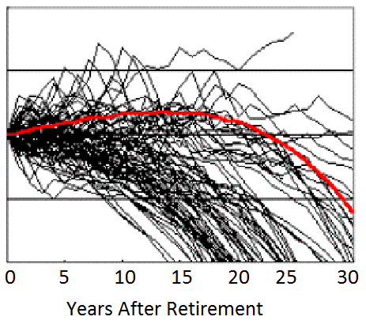
Advanced Retirement Planning
Lets Add Actual Market History
Each black line displays that actual result that would have occurred if the retirement was started in each of the one-hundred years during the last century. Sadly, 90% of historic outcomes failed to reach the standard single line forecast.
Failure rate: 90%
Success Rate: 10%
Notes:
9

Slide 10
Advanced Retirement Planning
Advanced Retirement Planning
90% Probability Of Success
(Red line or above)
(based on actual history)
__________________________________________________________
Standard Retirement Forecast: 10% probability of success
Advanced Retirement Planning: 90% probability of success
Notes:
10

Slide 11
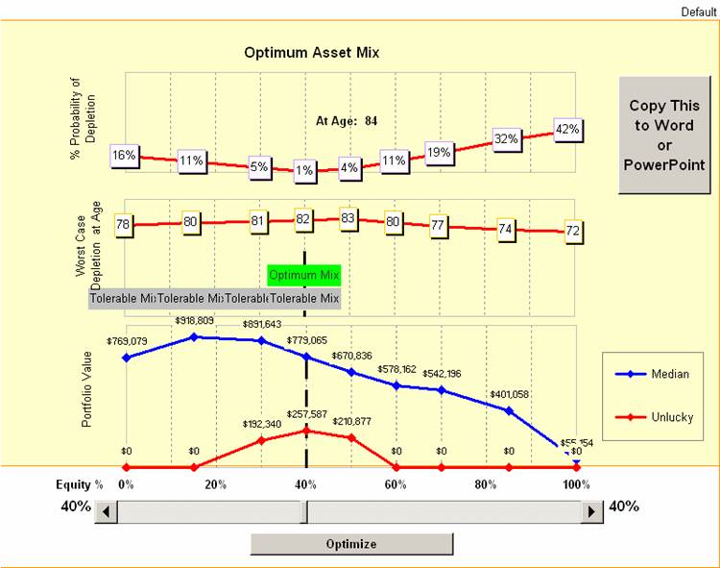
Investment Risk
Advanced Retirement Planning
Notes:
11

Slide 12
Zone Analysis
Advanced Retirement Planning
The advanced retirement planning analysis displays a simple outlook according to the “Zone Analysis” (90% probability of success).
Green Zone: Abundant resources for lifelong income
Grey Zone: Sufficient resources for lifelong income
Red Zone: Insufficient resources for lifelong income
Do you know where you stand
with your retirement readiness?
Notes:
12

Slide 13
Disclaimer
Advanced Retirement Planning
The material contained herein is for information purposes only and is not to be construed as an offer or solicitation for the sale or purchase of securities. While the information herein cannot be guaranteed, it was obtained from sources believed to be reliable, but in providing it, PI Financial Corp. does not assume any liability. PI Financial Corp. and/or its’ officers, directors, employees and affiliates may, from time to time, acquire, hold or sell a position in the securities mentioned herein.
This report is intended for distribution in those jurisdictions where PI Financial Corp. is registered as an advisor or a dealer in securities. Any distribution or dissemination of this report in any other jurisdiction is strictly prohibited.
PI Financial Corp. is licensed as a broker-dealer in all provinces and territories of Canada and is a member of the IIROC and the Canadian Investor Protection Fund.
Notes:
13

